Slide 1
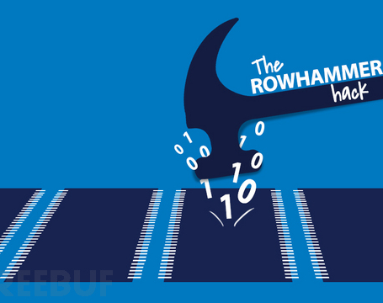
RowHammer: A Summary
CARAS
A r c h & S e c
Presenter: Haowen Liu
Time: 21st Dec. 2020

Slide 2
Outline
Risks in Comfort Zone
DRAM Background
Disturbance Error Phenomenon -> RowHammer
Characterization
Exploitation
Mitigation
Conclusion

Slide 3
Risks in Comfort Zone

Slide 4
Risks in Comfort Zone
Classical Security issues most focus on software-level security.
Authority control, process isolation, digital signature, cryptosystems, …
Popular tools and methodologies can address most security problems.
Most of these techniques fit well with their "all-round" threat model.
There is nothing new to be addressed in security now. All that remains is to reuse our threat models to address more and more new-born software vulnerabilities.

Slide 5
Risks in Comfort Zone
But how about the underlying hardware architecture?
All your threat models are based on the assumption that the underlying architecture is secure enough to support these upper-structure security techniques.
Well, it’s intuitively secure enough though, with many years’ demonstration in universal implementations. So there's no need to be paranoid.

Slide 6

Risks in Comfort Zone
RowHammer

Slide 7
Risks in Comfort Zone
RowHammer can break through most of existing software-level security mechanisms, for it attacks the basis of all of them: DRAM.
Authority control: flip authority control bits to obtain authority.
Privilege control: flip instruction bits to escalate privilege.
Process isolation and sandbox: corrupt processes in adjacent rows by bit flips.
Digital signature and cryptosystems: flip bits in public keys to factorize them.
No comfort zone now, so get up and go to work :-)

Slide 8
DRAM Background

Slide 9
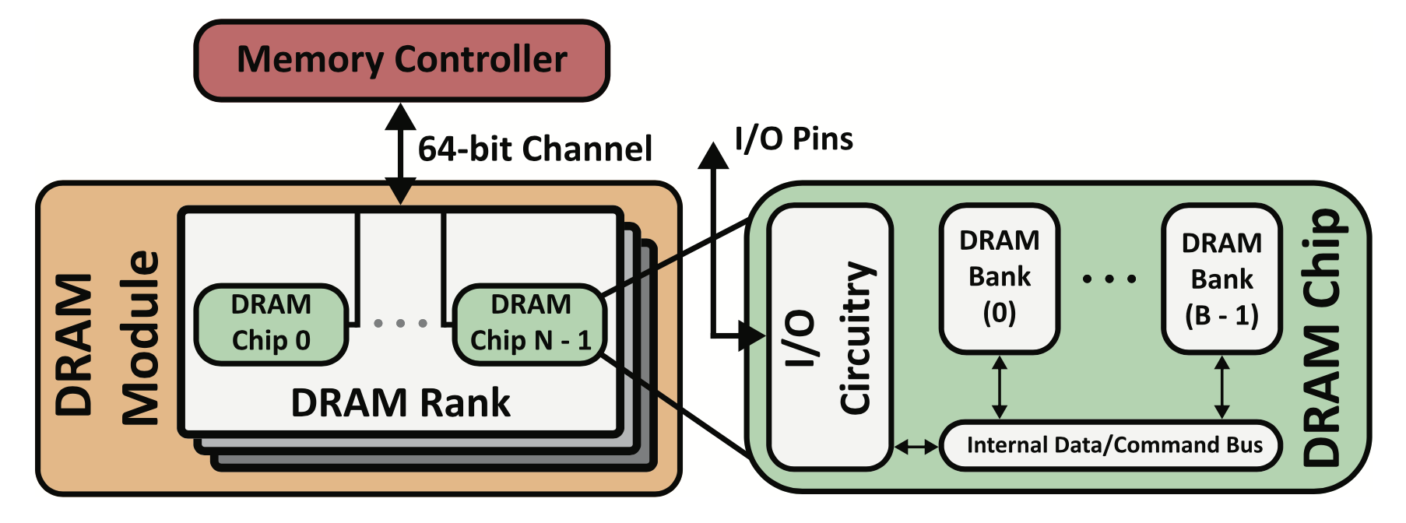
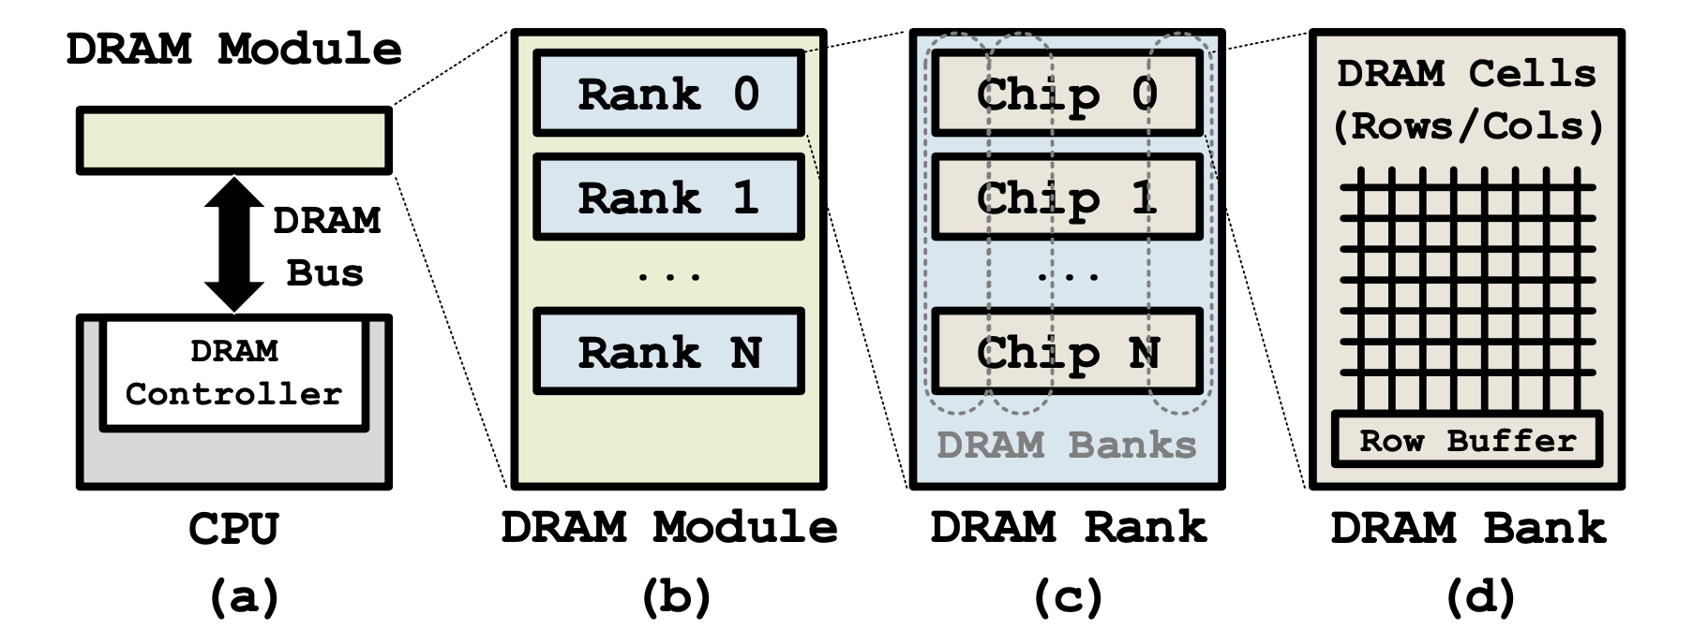
DRAM Background: Organization
How to describe a DRAM address of a bit?
a 6-tuple of the form <channel, DIMM, rank, bank, row, column>

Slide 10
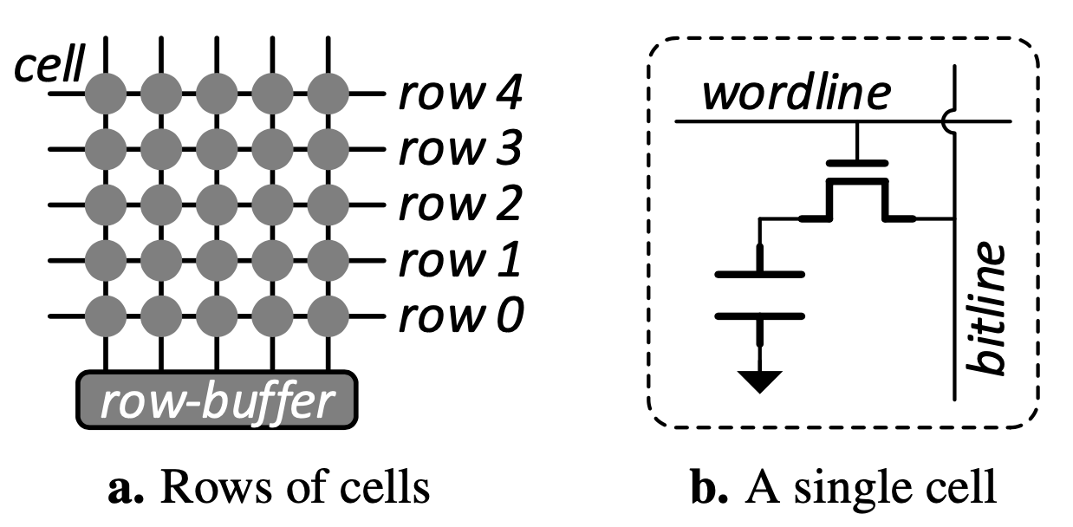
DRAM Background: Organization
Take a closer look to the cells.

Slide 11
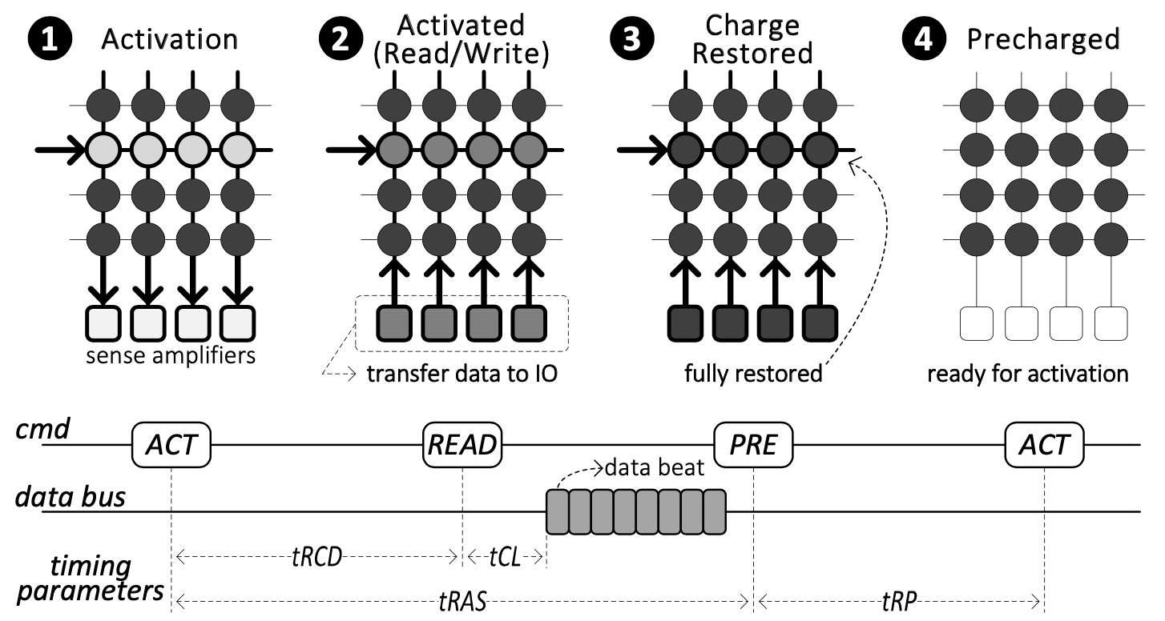
DRAM Background: Operation
Activation, restoration and precharge.

Slide 12
Disturbance Error Phenomenon -> RowHammer

Slide 13
Disturbance Error Phenomenon
DRAM cells leak charge all the time, so refreshed in a certain interval.
Repeated toggling of a DRAM row’s wordline stresses inter-cell coupling effects that accelerate charge leakage from nearby rows. When such a cell loses too much charge in a refresh interval, it experiences a disturbance error.

Slide 14
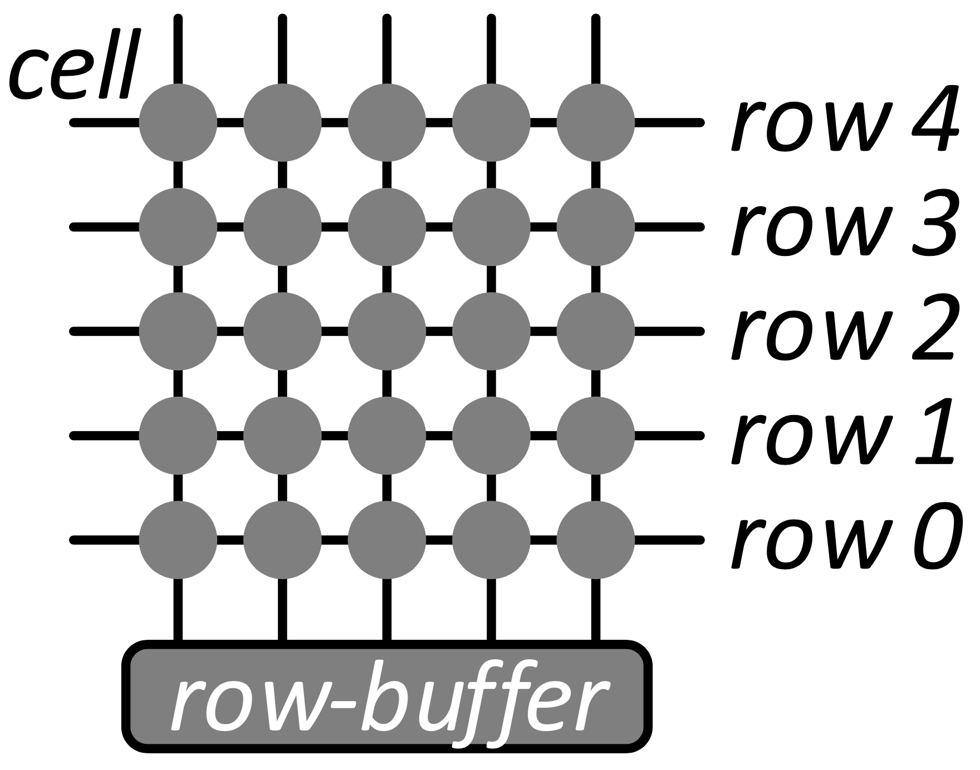
Disturbance Error Phenomenon

Slide 15
RowHammer
Malicious attackers can exploit disturbance error phenomenon to break the memory isolation security principle to cast great threat on computer system.
In later works, the exploitation of disturbance error phenomenon is called RowHammer, meaning repeatedly "hammering" a row induces bit flips into adjacent rows.

Slide 16
Characterization

Slide 17

Characterization: Circuit Level
DRAM disturbance errors are caused by the repeated opening/closing of a row, not by column reads or writes.
Disturbance Errors are widespread across DRAM types and vendors.
Sensitivity Results: errors are mostly repeatable; victim cells ​$≠$ weak cells; not strongly affected by temperature (but affected).

Slide 18
Characterization: Circuit Level
Access Pattern Dependence: the more activations in a refresh interval, the more bit-flip errors.
Address Correlation: an aggressor row and its victim rows are likely to have consecutive physical row-addresses, i.e., physically adjacent.
Data Pattern Dependence: despite rare exceptions, every other victim cell (cell experiencing bit flip) had an error in just a single preferred direction (leakage direction). For example, one cell can only be flipped from 1 to 0​ but cannot reverse.

Slide 19
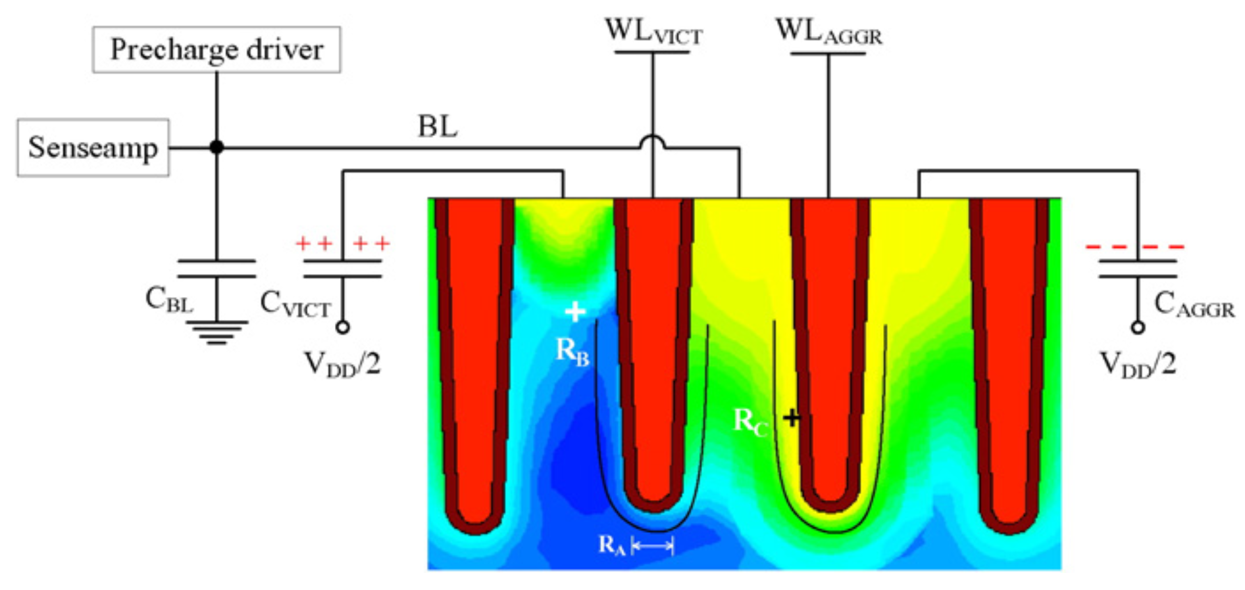
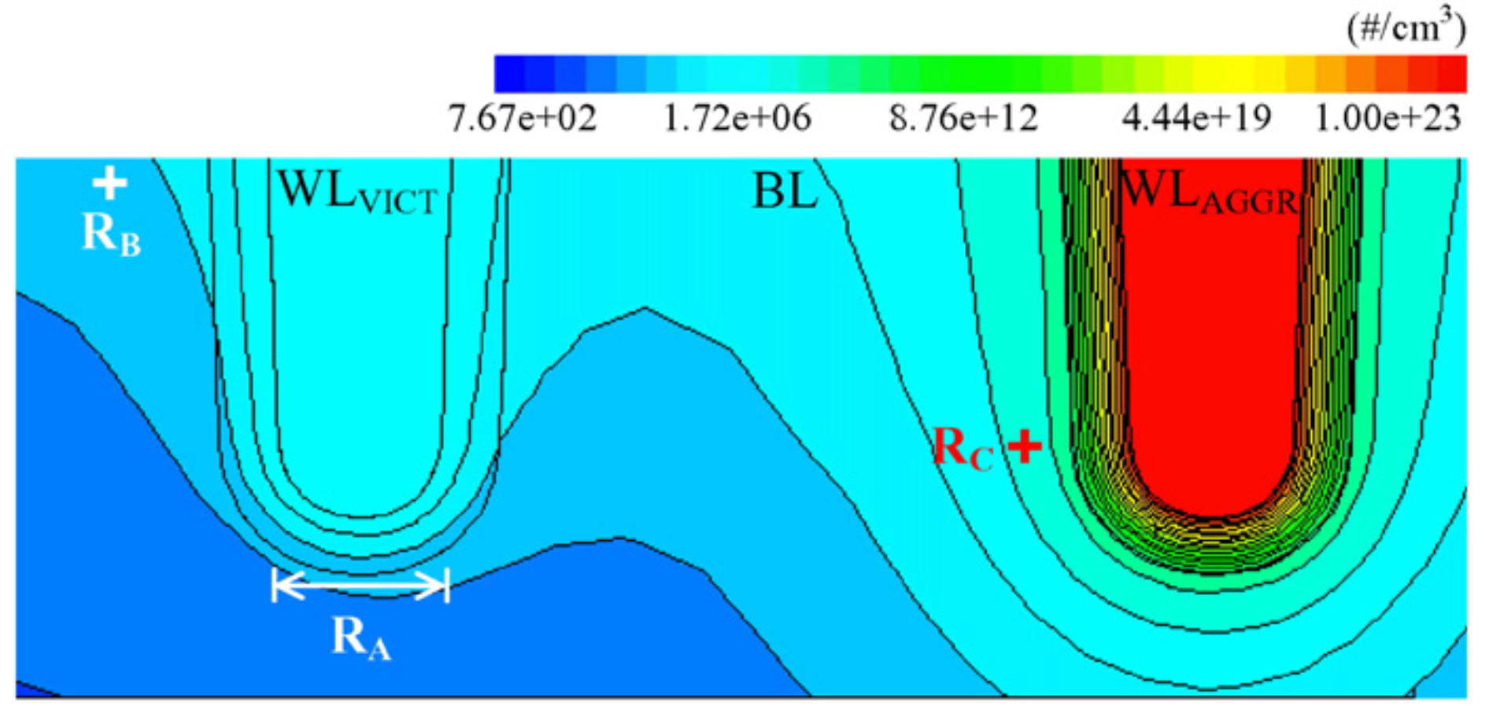
Characterization: Semiconductor Level
RowHammer fault is primarily caused by the charge recombination (electrons and charges combine to electrical neutrality) of the victim cell with the charges in the channel of the neighborhood cell.

Slide 20
Characterization: Semiconductor Level
Leakage of the victim cell decreases with the increasing of P-well doping concentration, geometrical distance between the aggressor and the victim cells. Data pattern P0/1 is much vulnerable than P1/1 (Pa/b means the left cell stores value a and the right cell stores the value ​b).
A deeper bit-line junction mitigates row hammer effect, since it intercepts more electron carriers during migration.

Slide 21
Exploitation

Slide 22
Exploitation
Exploitation of RowHammer covers almost every field of computer security, generates lots of innovative attack vectors and methodologies and force many mechanisms to be disabled or look for substitutes.
Notes:
Rowhammer attacks can target a variety of data structures, from page table entries [30, 34, 36, 37] to cryptographic keys [28], and from object pointers [6, 13, 32] to opcodes [14]. These target data structures may reside in the kernel [30, 34], other virtual machines [28], the same process address space [6, 13], and even on remote systems [32]. The attacks may originate in native code [30], JavaScript [6, 15], or from co-processors such as GPUs [13] and even DMA devices [32]. The objective of the attacker may be to escalate privileges [6, 34], weaken cryptographic keys [28], compromise remote systems [32], or simply lock down the processor in a denial-of-service attack [18].

Slide 23
Exploitation
Security techniques broken through by RowHammer:
Privilege/authority control: [], Drammer [], [], [], Dedup Est Machina []
Process isolation, sandbox and virtual machine: Project Zero [], Dedup Est Machina [], Flip Feng Shui [], ECCploit []
Digital signature and cryptosystems: Flip Feng Shui [], ECCploit []
Denial-of-service: Locking down the processor []
Remote system/network: Throwhammer []

Slide 24
Exploitation
Three classical/representative exploitations used in many works to evaluate attack feasibility:
exploit targeting PTEs (Page Table Entries) to obtain kernel privileges
representative: Drammer
corrupts RSA public keys to gain access to a co-hosted VM
representative: Flip Feng Shui
flip bits on the sudo binary opcode to bypass permission checks
representative: Another Flip

Slide 25
Exploitation
The common 3-step attack methodology (firstly proposed by FFS):
Memory Templating: find the RowHammer templates in memory, such as row addresses, access patterns, bit-flip offsets and directions and data patterns.
Memory Massaging: steer targeted sensitive data towards the vulnerable physical memory locations found in memory templating step.
Exploitation: exploit RowHammer bit flips to compromise target systems.
Using FFS an example

Slide 26
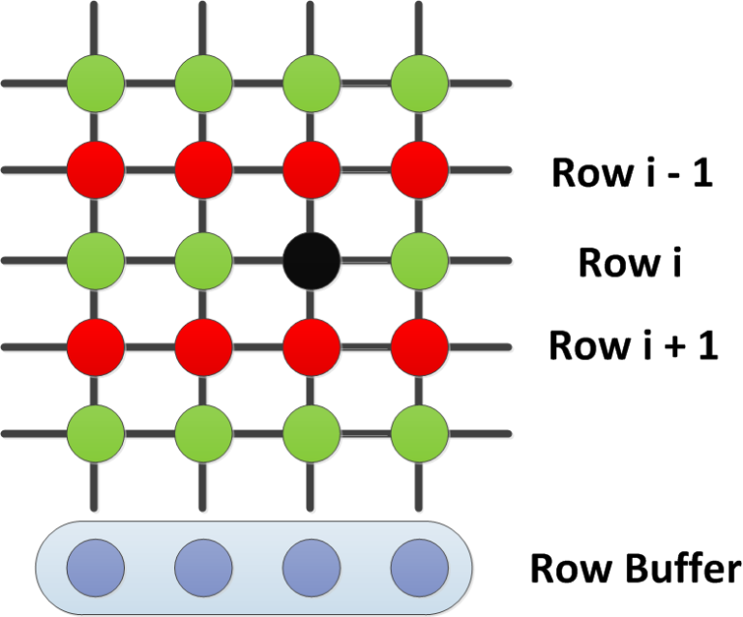
Exploitation: Example - Memory Templating
FFS conducts memory templating to get the knowledge of usable bit-flip patterns (bit-flip direction, bit-flip offset, and data pattern of the page) using a variant of double-sided RowHammer.

Slide 27
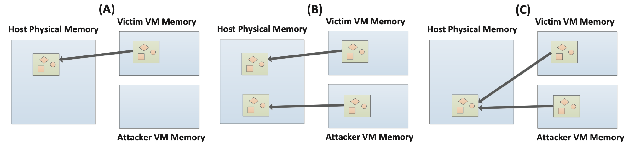
Exploitation: Example - Memory Massaging
FFS exploits memory deduplication to steer targeted sensitive data towards the vulnerable physical memory locations found in memory templating step.
Memory deduplication can provide an attacker control over the layout of physical memory.

Slide 28
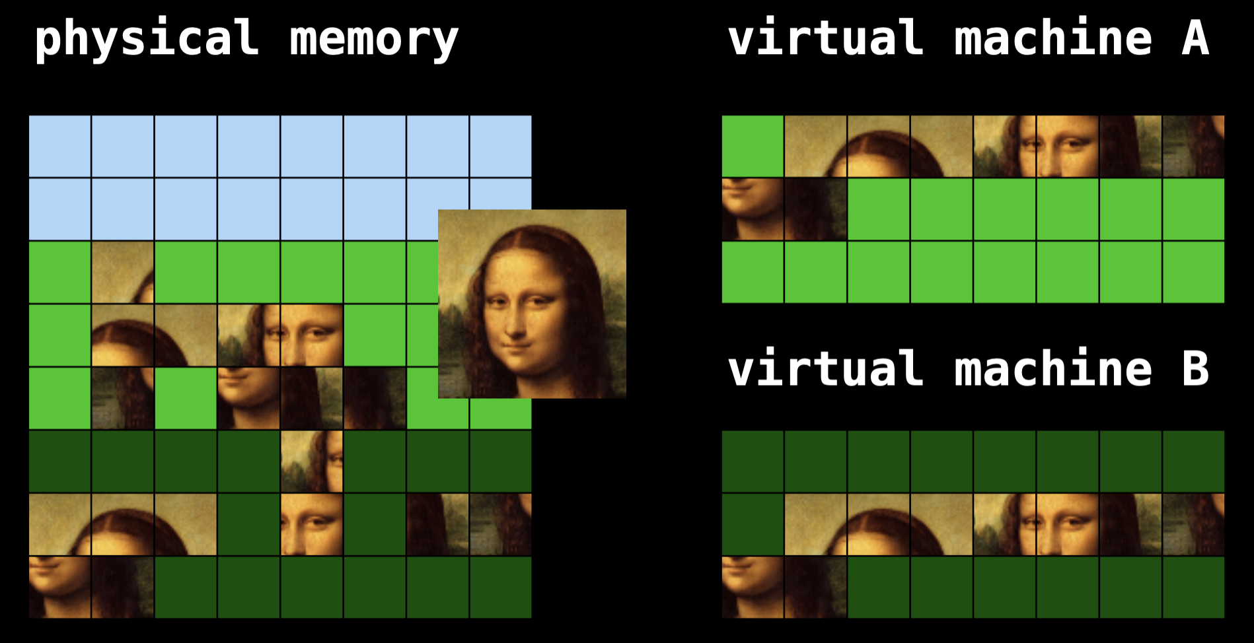
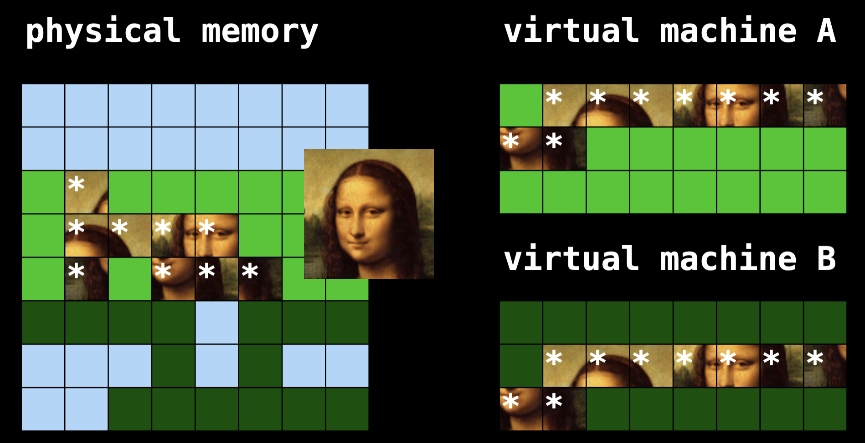
Exploitation: Example - Memory Massaging

Slide 29
Exploitation: Example - Exploitation
Finally, FFS uses RowHammer to induce bit flips in RSA public keys in co-hosted VM’s memory, factorize them and generate private keys, successfully compromising OpenSSH and apt package distribution system in a co-hosted cloud VMs.

Slide 30
Mitigation

Slide 31
Mitigation: Hardware-Level
Double refresh rate
Multiple-bit-correction ECC
Counter-Based structure
Probabilistic Adjacent Row Activation

Slide 32
Conclusion

Slide 33
Conclusion:
Leakage of the victim cell decreases with the increasing of P-well doping concentration, geometrical distance between the aggressor and the victim cells. Data pattern P0/1 is much vulnerable than P1/1 (Pa/b means the left cell stores value a and the right cell stores the value ​b).
A deeper bit-line junction mitigates row hammer effect, since it intercepts more electron carriers during migration.

Slide 34
References
[1]

